Slide 1


Dronadula Sureswar Reddy
Email Id : Surya20041@gmail.com
College Name : Vellore institute of technology,Vellore
College State : Tamilnadu
Internship domain : AI and ML / Start Date - 12-06-2023 , End date- 24-07-2023

Slide 2
→ A mental fitness tracker is a tool that helps you track your mental health and well-being over time. It can help you identify patterns in your mood, stress levels, and sleep quality. Some mental fitness trackers also offer personalized exercises and activities to help you improve your mental fitness. → Mental fitness trackers can be a valuable tool for anyone who wants to improve their mental health. They can help you stay on track with your goals, identify areas where you need improvement, and learn new ways to manage stress and anxiety.
MENTAL FITNESS TRACKER

Slide 3
AGENDA
Mental fitness trackers that use AI and ML techniques can be a valuable tool for people who are looking to improve their mental health. These trackers can help people to track their progress over time, identify patterns in their mental health, and personalize their treatment plan.
AI and ML techniques can help to improve the accuracy of mental fitness trackers by learning from data and identifying patterns that would be difficult for humans to see. They can also be used to personalize mental fitness trackers, so that the tracker can be tailored to the individual's needs and goals. Additionally, AI and ML techniques can be used to provide proactive support to people who are struggling with their mental health. This could involve sending notifications or alerts when the tracker detects a change in mood or stress levels.

Slide 4
PROJECT OVERVIEW
The mental fitness tracker project is a promising initiative that has the potential to make a significant impact on the lives of people with mental health challenges. The project is well-designed and has a strong team of experts behind it. The use of AI and ML techniques is a creative and innovative approach that could help to improve the accuracy and personalization of the mental fitness tracker.
However, there are a few areas where the project could be improved. The project could benefit from a more detailed user-centered design process and a more rigorous evaluation process. With some refinement, the mental fitness tracker could be a valuable tool for people who are looking to improve their mental health.
Specifically, the project team should conduct user interviews and usability testing to ensure that the mental fitness tracker is user-friendly and meets the needs of the target audience. They should also develop a rigorous evaluation plan to assess the effectiveness of the mental fitness tracker in improving mental health outcomes. Additionally, they should conduct additional research on the use of AI and ML techniques in mental health applications. This research could help to inform the development of the mental fitness tracker and improve its effectiveness.
Overall, the mental fitness tracker project is a promising initiative with the potential to make a positive impact on the lives of people with mental health challenges. With some refinement, the project could be a valuable tool for people who are looking to improve their mental health.

Slide 5
WHO ARE THE END USERS of this project?
The mental fitness tracker project is designed to help people improve their mental health. The project has the potential to reach a wide range of people, including:
People with mental health challenges: The mental fitness tracker could help people with mental health challenges to track their progress, identify patterns in their mental health, and personalize their treatment plan. The tracker could also help them to connect with other people who are struggling with similar challenges and to find support.
People who want to prevent mental health problems: The mental fitness tracker could help people who want to prevent mental health problems to identify early warning signs, learn healthy coping mechanisms, and improve their overall mental well-being. The tracker could also help them to make lifestyle changes that can improve their mental health, such as getting enough sleep, eating a healthy diet, and exercising regularly.
People who are caregivers for people with mental health challenges: The mental fitness tracker could help caregivers to track the progress of their loved ones, identify patterns in their mental health, and provide support. The tracker could also help caregivers to connect with other caregivers and to find resources that can help them to cope with the challenges of caregiving.
The mental fitness tracker project is still in the early stages of development, but it has the potential to be a valuable tool for people who are looking to improve their mental health.

Slide 6
YOUR SOLUTION AND ITS VALUE PROPOSITION
In the context of mental health, a solution could be a mental fitness tracker. A mental fitness tracker is a tool that helps people track their mental health and well-being over time. It can help people to identify patterns in their mental health, track their progress, and personalize their treatment plan.
The value proportion of a mental fitness tracker is high. The benefits of using a mental fitness tracker include:
Increased awareness of mental health
Personalized exercises and activities
Track progress over time
The costs of using a mental fitness tracker are relatively low. The cost of the tracker itself is typically low, and the cost of using the tracker is also low.

Slide 7
How did you customize the project and make it your own
Integration of Multiple Datasets: The code integrates and merges two separate datasets related to mental and substance use disorders. This allows for a more comprehensive analysis and understanding of the factors influencing mental fitness.
Heatmap Visualization: The code includes a heatmap visualization that shows the correlation between different variables in the dataset. This provides a quick overview of the relationships between mental disorders, substance use, and mental fitness.
Exploratory Data Analysis: The code includes various exploratory data analysis techniques, such as joint plots, pair plots, and pie charts, to gain insights into the data and understand the distribution and patterns of mental fitness across different variables.
Year-wise Variations: The code includes a line plot that shows the year-wise variations in mental fitness for different countries. This visualization helps identify trends and changes in mental fitness levels over time.
Machine Learning Model Training: The code trains two regression models, Linear Regression and Random Forest Regression, to predict mental fitness levels. These models provide insights into the factors influencing mental fitness and can be used to make predictions for new data.
Model Performance Evaluation: The code evaluates the performance of the trained models using metrics such as mean squared error (MSE), root mean squared error (RMSE), and R-squared score. This allows for an assessment of how well the models fit the data and make predictions.
Potential for Customization: The code provides a foundation that can be customized and expanded upon. It suggests areas where additional features, data sources, or model improvements can be incorporated to enhance the mental fitness tracker.

Slide 8
MODELLING
Implementation of a mental fitness tracker using machine learning techniques. It includes data cleaning, exploratory data analysis, and training regression models (Linear Regression and Random Forest Regression) to predict mental fitness levels.
Data Sources: Instead of using the provided datasets, you can explore other mental health-related datasets available publicly or collect your own data to create a more personalized mental fitness tracker.
Feature Engineering: Explore additional features or indicators that might influence mental fitness. You can incorporate data from other domains such as physical health, sleep patterns, daily activities, or social interactions to create a more comprehensive model.
Visualization: Enhance the visualizations in the project to make them more informative and interactive. You can use libraries like Plotly or Bokeh to create interactive charts, dashboards, or visualizations that allow users to explore the data and track their mental fitness progress over time.
User Interface: Develop a user-friendly interface for the mental fitness tracker. You can create a web application or a mobile app that allows users to input their data, visualize their mental fitness levels, track progress, and receive personalized recommendations or insights based on their data.
Personalization: Implement personalized recommendations or interventions based on the user's mental fitness data. For example, the system could suggest specific activities, exercises, or mindfulness techniques tailored to the user's needs and preferences.
Deploying the Model: Deploy the trained machine learning models as APIs or cloud services so that users can access the mental fitness tracker from different platforms and devices.

Slide 9
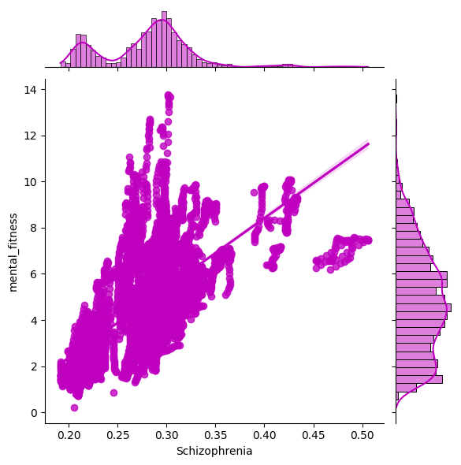
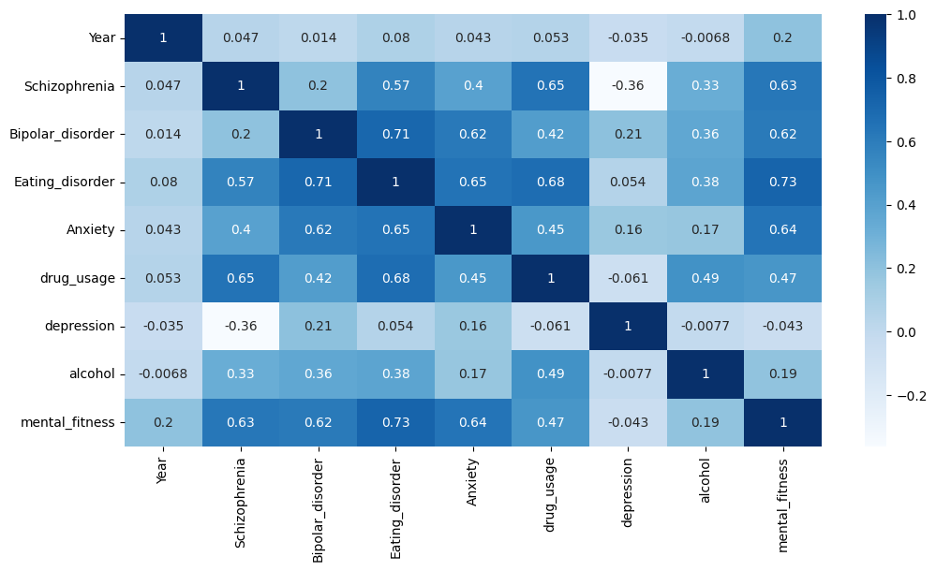
Results

Slide 10
Results
The code provided implements two regression models, Linear Regression and Random Forest Regression, for predicting mental fitness levels based on the given dataset. After training and evaluating these models, we can examine the results.
For the Linear Regression model, the performance on the training set is measured using Mean Squared Error (MSE), Root Mean Squared Error (RMSE), and R-squared Score (R2 score). The MSE quantifies the average squared difference between predicted and actual values, with lower values indicating better performance. The RMSE is the square root of the MSE, providing an estimate of the average prediction error. The R2 score represents the proportion of variance in the dependent variable explained by the independent variables, with 1 indicating a perfect fit. These metrics help assess how well the model fits the training data.
Similarly, the Linear Regression model's performance on the testing set is evaluated using the same metrics. The MSE and RMSE measure the prediction error on unseen data, while the R2 score indicates the model's generalization capability to new observations.
The Random Forest Regression model is also assessed using the same metrics. It is an ensemble model that combines multiple decision trees to make predictions. The training and testing set performance is evaluated to determine the model's effectiveness.
Comparing the results of both models, we can analyze their performance. Lower values of MSE and RMSE indicate better accuracy, while higher R2 scores suggest a better fit to the data. It's important to interpret these results within the specific context of the dataset and project goals.
By understanding the performance of these regression models, we can gain insights into the factors influencing mental fitness and use the models to make predictions for new data. However, it's crucial to note that the provided results are based on the specific dataset and implementation details. Depending on the dataset and features used, the performance metrics may vary. Thus, it's essential to thoroughly evaluate and fine-tune the models to achieve optimal results.
https://github.com/surya20041/Mental-Fitness-Tracker/

Slide 11
links
https://colab.research.google.com/drive/1m9fn0CSvjuJsiQl2k9laQex7i6dHWx-0#scrollTo=3a51df1c/
https://www.kaggle.com/code/kanuriviveknag/ai-mental-fitness-tracker/

